Slide 1
Programming Quantum Computers

Slide 2

What is (up with)
Quantum Computing?
Different Paradigm
Bits vs Qubits

Slide 3


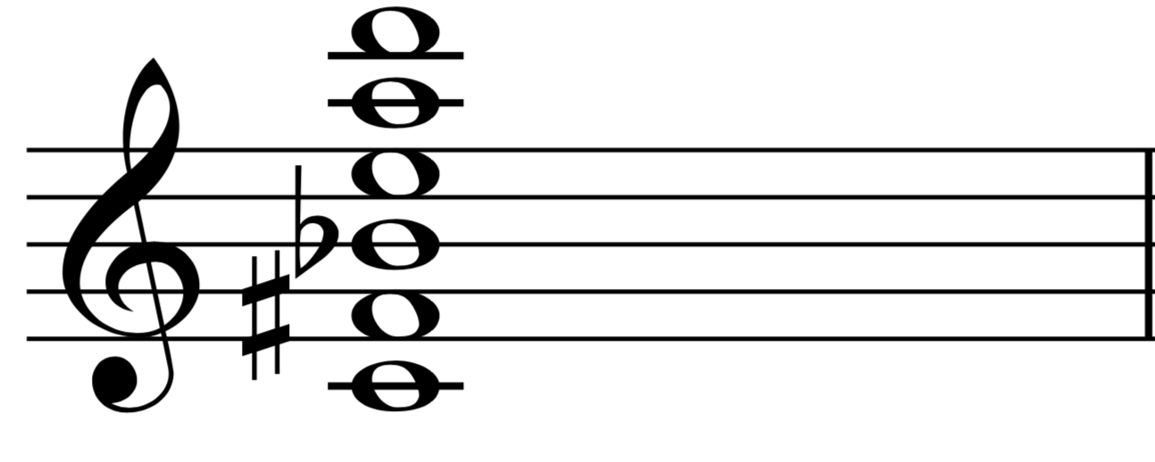
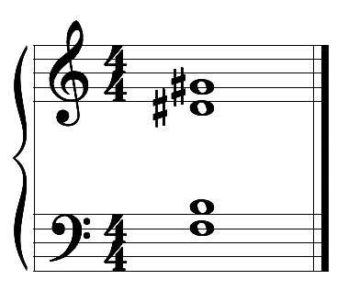
Superposition and Entanglement

Slide 4
What is (up with)
Quantum Computing?
Why?
Notes:
Algorithms exist for certain problems that are much faster than currently known classical solutions
large-scale optimization problems,
complex simulations (molecular modeling in chemistry)
factoring large numbers - breaking certain encryption algorithms,
complex combinatorial problems
finding optimal solutions in complex logistics scenarios

Slide 5

Physical Research: Current State
Different approaches to Qubits (photons, trapped ions, superconducting etc.)
Different Models
Not yet at scale (variably 5-10 years : )
Big challenges remain: Scalability, Error Correction…

Slide 6

How do we program them?
Different Models of QC
NISQ + Variational QC?
High Level?
Complicated - soundness?
Lack of Resources - correctness?
Debugging?
Quantum Control?

Slide 7
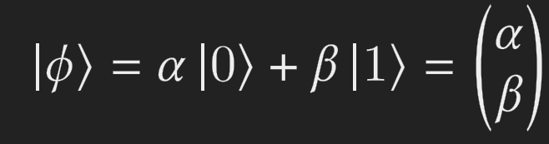
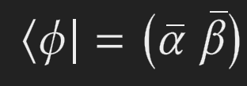
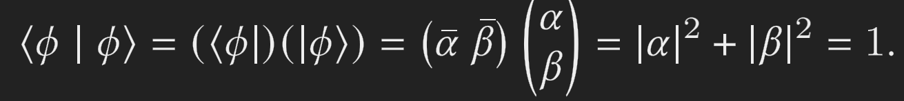
The shortest of primers
A Qubit’s state is typically represented by a normalized vector (in a 2 dimensional Hilbert space)
Notes:
Storing vs Communicating information

Slide 8
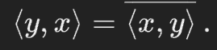
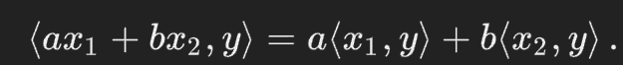
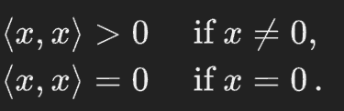
Hilbert Space
A Hilbert space is a real or complex inner product space that is also a complete metric space with respect to the distance function induced by the inner product.
Meaning It has an inner product associating a complex number to each pair of elements x and y of H with the following properties:

Slide 9

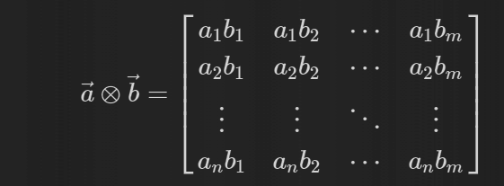
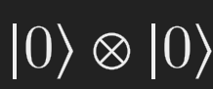

More than one Qubit
=

Slide 10
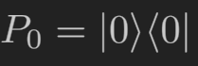

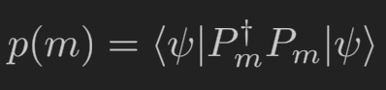
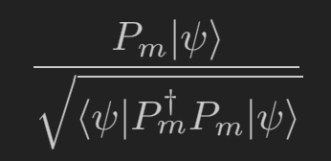
Measurement
A measurement on a quantum system has some set M of outcomes [for the single qubit, 0 and 1)
A measurement is described by the associated measurement operator P associated with a given m in M (linear operators acting on the state space, projecting onto the relevant subspace for m) [ for us, ]
So then the probability of outcome m is
And the state after (successful) measurement is

Slide 11
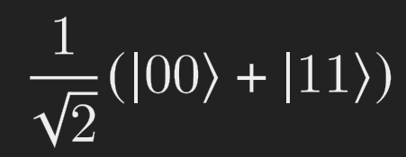
Entanglement
Such states as can be written are separable.
Such that cannot, are entangled, e.g.
Now, we can put a concrete meaning behind the concept by looking at what happens when we measure.

Slide 12
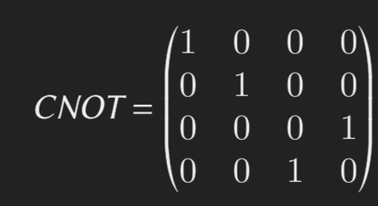
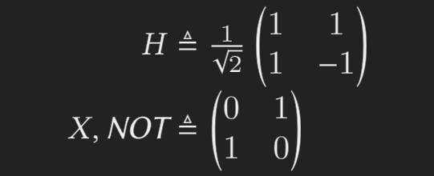
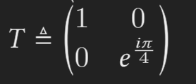
Quantum Operations
QRAM
Unitary ops & Measurements
Unitary: linear, invertible (and sends orthonormal bases to orthonormal bases)
In general, a small set of (universal) gates

Slide 13
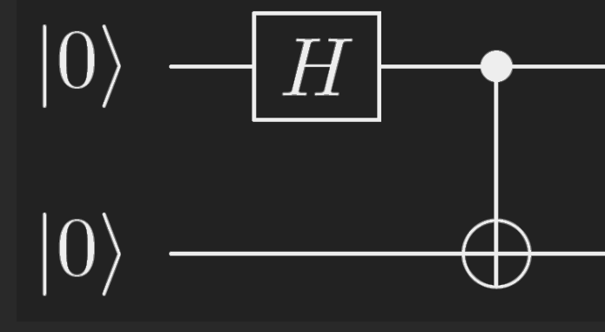

Slide 14
Quantum Programming : The Naive Way
circuit = QuantumCircuit(q,c)
circuit.h(q[0]) # Hadamard gate
circuit.cx(q[0],q[1]) # CNOT gate
circuit.measure(q,c) # Qubit Measurement

Slide 15
Quantum Programming Paradigms : Somewhat Historically
b.o.Valiron 2022
Quantum Programming, Classical Environment (Betteli et al. C++)
Generally imperative
Qiskit - or how to make the same mistake for the millionth time 101
Circuits as side-effects
Altenkirch & Green, QIO, formality
Quipper
Circuits as Functions
Quantum and classical arrows
Theseus
Quantum-Specific Programming
Quantum control, QCL, QML
Quantum Lambda Calculus
Graphical Calculi
Embedded
VS
Standalone
First-Order
VS
Higher-Order
Notes:
All within QRAM for now

Slide 16
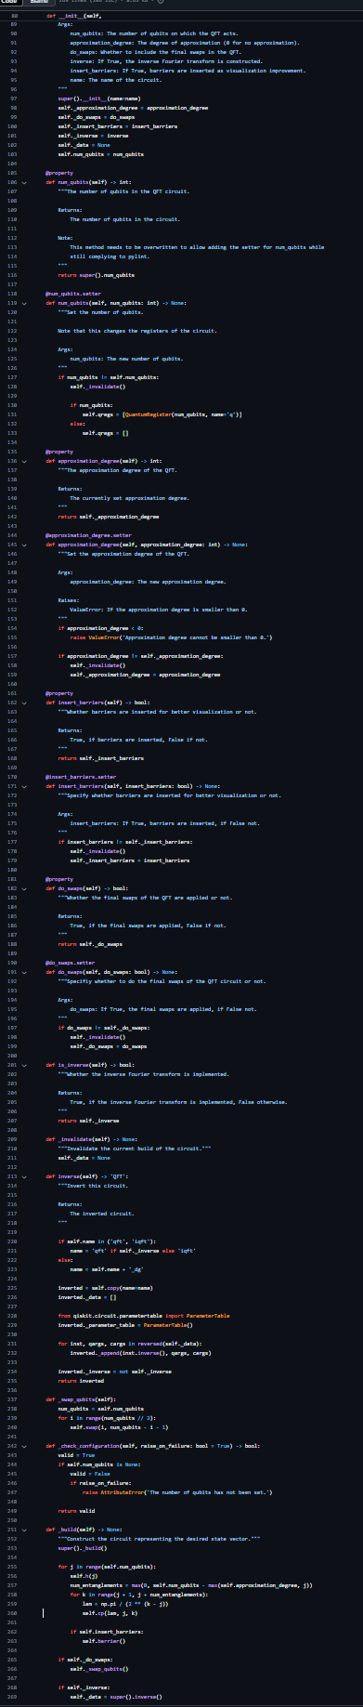
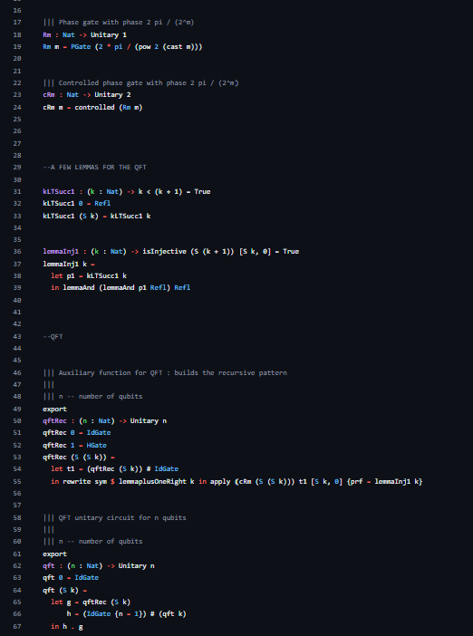
A Teachable Note : The QFT
QISKIT
Qimaera

Slide 17
Quantum Lambda Calculus (van T., Valiron, Selinger)
Formalizes the notion of quantum, higher-order functional programming language with classical control
Set of constructs and an operational semantics to formalize the interaction with the coprocessor.
Main theoretical tool behind the state-of-the-art for QP and QPCert
qubit type, meas and qinit terms, gate constants U
How to incorporate qubit objects?

Slide 18
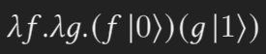
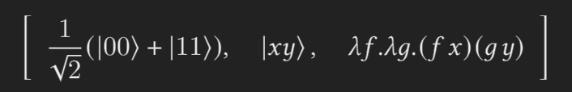
Quantum Closures
?
cbv

Slide 19
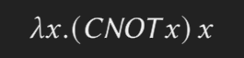
Linear Typing
Quantum data cannot be duplicated!

Slide 20
Not Quite Enough
In Quantum Algorithms, circuits are described with
Sets of gates, explicitly
Circuit combinators: Inversion, control, repetition, etc
Need circuits as first-class objects

Slide 21
What should a Quantum language be like?
Allow manipulation of quantum registers circuits as first-class objects.
Description of parametric families of quantum circuits (applicative, procedural)
Classical processing
Ideally: Ensure soundness wrt QC
Ideally: Can reasonably check some useful notion of correctness
Ideally: Integrated Quantum Control

Slide 22
Circuit Description Languages : Quipper
First scalable QPL -> Quipper
Extends QLC with
Circ(A,B) [opaque]
Instantiating Circuits (“box”)
Evaluating Circuits (“unbox”)
A list of fixed, opaque circuits combinators (control, reverse…)
Nice cat semantics :D

Slide 23

A Bit Further with Dependency

Slide 24
Example: Grover’s Algorithm
Suppose we have f: {0…N} -> {0,1}. We have a database where only one index i satisfies f.
Normally, this is a linear problem.
Quantumly, we can construct a quantum operator U_i from f (which marks the relevant entry by flipping its phase).
We can then use this to find the entry in the following way:

Slide 25
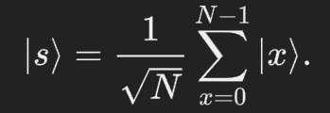

Example: Grover’s Algorithm
Initialize all qubits (sqrt of the size of the database) to equal superposition:
The repeat the following pi/4 sqrt(N) times
Apply U_i
Apply where s is 0^N [initial state]
Profit (measure the resulting state in the cb - probability of success is at least 1/2)

Slide 26
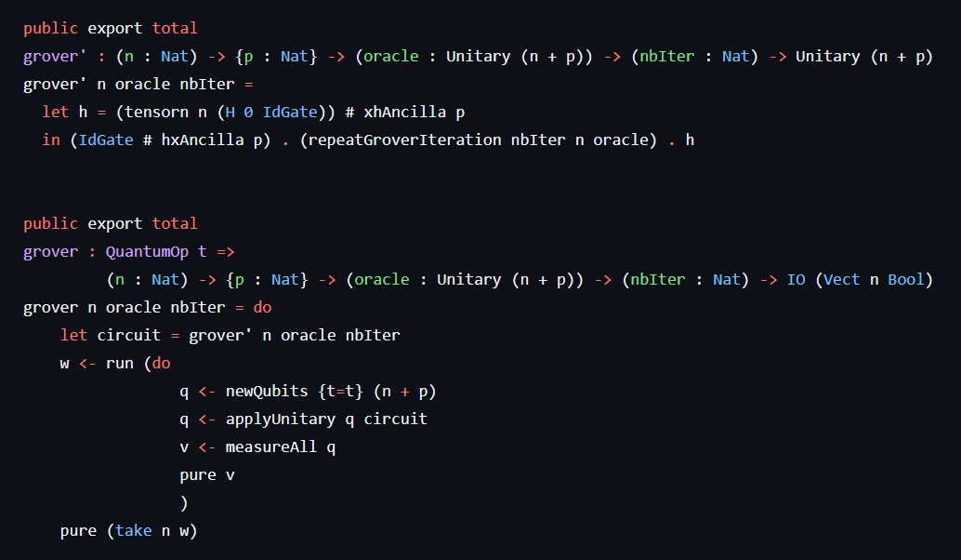
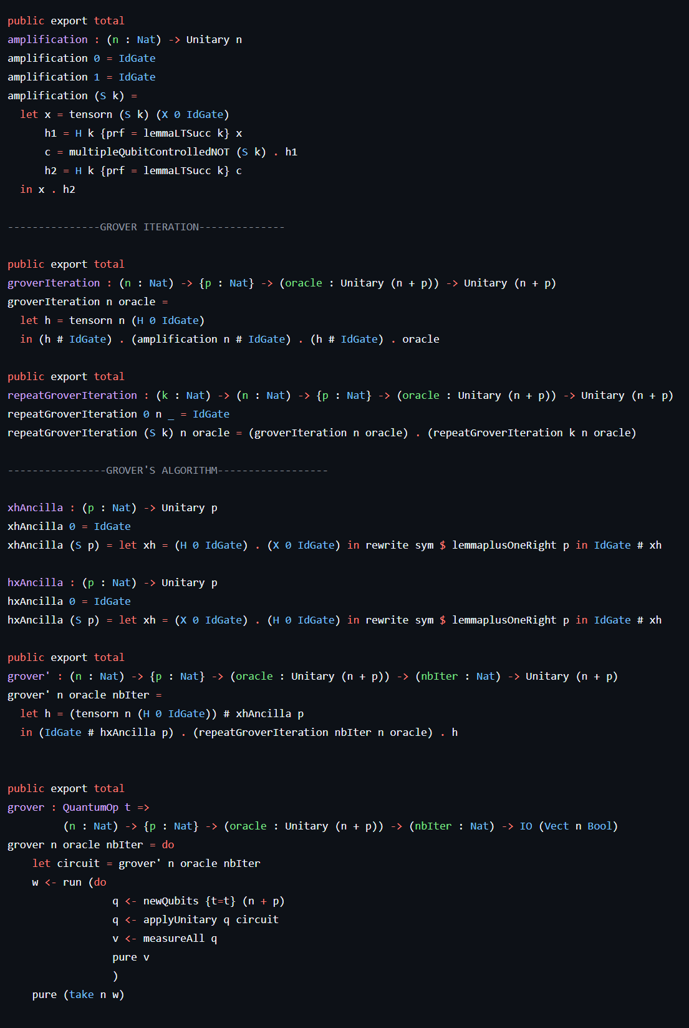
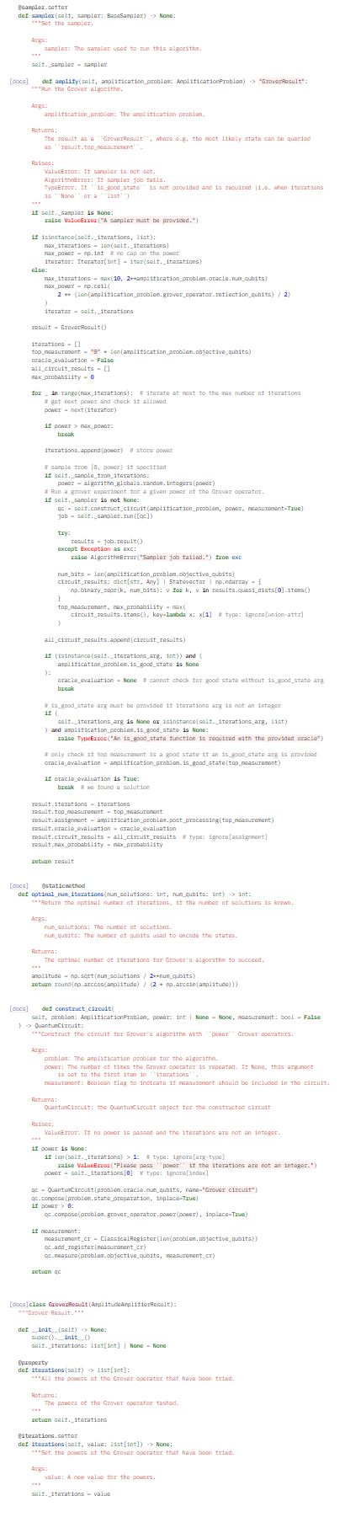

Slide 27
Quantum Control
The circuit construction is classical
Built on classical machine, instantiated for a particular set of qubits, and applied irrespective of the state of memory
Combinators are opaque and non-programmable
For building circuit combinators in a general form, we need quantum control

Slide 28
Issue 1: Quantum Closures

Slide 29
Issue 2: Combining Quantum and Classical Control

Slide 30
Operator Space Semantics:
Toward a Unified Solution to 1 and 2
The idea is to define an operational semantics where we move via certain types of maps from an operator space of terms to an operator space of terms.

Slide 31


